Slide 1
Advanced C++
Chapter 17 – Files (Part 2)
Fall 2011
Kristina Shroyer

Slide 2
Objectives
In this chapter you will learn how to:
  Binary Files
  Creating records (of fields) for files with structs
  Random Access Files

Slide 3
Binary Files
Concept: Binary files contain data that is unformatted and not necessarily stored as ASCII text
All the files we worked with last time were text files
  Meaning the data stored in the files was formatted as ASCII text
  Even a number, when stored in a file with the << operator is converted to text
So let's say we have this code:
  ofstream file("num.dat");
  short x = 1297;
  file << x;
The last statement writes the contents of x to our file
  When the number is written it is stored as characters like so:
    | '1' | '2' | '9' | '7' |<eof>|
    Which expressed in ASCII is:
      This is how the data is formatted in our text files
    | 49 | 50 | 57 | 55 |<eof>|
Continued on next slide…..

Slide 4
Binary Files
Continued from previous slide…
However, even though our file data is formatted as shown on the previous slide we know that x the VARIABLE is stored in memory as a binary number occupying two bytes on the PC
  1297 as a short in binary:
    00000101 | 00010001
  1297 as a short in hex
    05 | 11
The unformatted representation of the number above is the way raw data is stored in memory in the computer
You can store memory in a file in its pure binary format at well

Slide 5
Binary Files
By default files are opened in text mode
  So we will need to take steps to open files in binary mode and use them in binary mode
The first step to store information in binary form in a file is to open the file in binary mode
A file can be opened in binary mode by using the ios::binary flag as in this example:
  file.open("stuff.dat", ios::out | ios::binary);

Slide 6
Binary Files – write member func.
The write member function of the ostream and ofstream classes can be used to write binary data to a file or other output stream
To call the write function you specify the address of a buffer containing an array of bytes to be written and an integer indicating how many bytes are to be written like so:
  write(addressOfBuffer, numberOfBytes);
The write member function does not care whether the buffer contains integers or floats or some other type:
  It instead simply views the buffer as an array of bytes

Slide 7
Binary Files – write and reinterpret_cast
C++ does not support the idea of a pointer that points to a byte so instead
  the prototype of the write function specifies that the address of the buffer should be a pointer to a char
    write(char *addressOfBuffer, int numberOfBytes);
What this means is that when we call write, we need to tell the compiler to interpret the address of the buffer as a pointer to a char
  We do this by using a special form of casting called a reinterpret cast
  The reinterpret_cast is used to force the compiler to interpret the bits of one type as if they defined a value of a different type
Example: let's say we wanted to (for whatever reason) convert a pointer to a double so it would be interpreted as a pointer to a char:
    double d = 45.9;
    double *pd = &d; //pd is a pointer to a double
    char *pChar;
    //convert pointer to double into pointer to char
    pChar = reinterpret_cast<char *>pd;
Here's the general format for using reinterpret_cast
  reinterpret_cast<TargetType>(value);

Slide 8
Binary Files – write and reinterpret_cast
Here are some examples of how to use write to write a double and an array of doubles to a binary file:
double d1 = 45.9;
double dArray[3] = {12.3,45.8,19.5};
ofstream outFile ("stuff.dat", ios::binary);
outFile.write(reinterpret_cast<char *>(&d1), sizeof(d1));
outFile.write(reinterpret_cast<char *>(dArray), sizeof(dArray));
  Notice that when we wrote a single variable (d1) we treated the variable itself as the buffer and passed its address (&d1) as the pointer to the buffer
  When we used the array as the buffer, we just passed the array (dArray) because the array is already an address
If the data we are writing to our binary file already happens to be character data, there is no need to use the cast
Example:
  char ch = 'X';
  char charArray[5] = "Hello";
  ofstream outFile ("stuff.dat", ios::binary);
  outfile.write(&ch, sizeOf(ch);
  outfile.write(charArray, sizeOf(charArray));

Slide 9
Binary Files – read member function
There is a read member function in the istream and ifstream classes that can be used to read binary data written by the write method
The read function takes as parameters the address of a buffer in which the bytes to be read are stored and the number of bytes to read:
  read(addressOfBuffer, numberOfBytes);
And with the write function the address of the buffer must be interpreted as a pointer to a char using the reinterpret_cast
  You can find out if the specified number of bytes was successfully read by calling the fail() member function on the input stream
The reinterpret_cast is a bit inconvenient to use so I'm going to create a header file called reinterpret.h and put this function in it to use when we do the rest of the examples:
    char* addr(void *p)
    {
    return reinterpret_cast<char*>(p);
    }
    Inline means the function will be copied and inserted into the code wherever it is used
    The parameter to the function is a void *. C++ allows pointers of any type to be assigned to a pointer of type void*.

Slide 10
Binary Files Example
Let's look at Example1

Slide 11
Creating Records with Structures
Concept: Structures may be used to store fixed length records into a file
Last time I mentioned the concept of fields and records
  A field is an individual piece of information pertaining to a single data item – can be data members of a class or struct
  A record is made of fields and is a complete set of information about a single item – can be represented by a class
  For example, a set of fields might be a person's name, age, address and phone number. Together all of those fields that pertain to one person make up a records
In C++, structs provide a way to organize information into fields and records.
  const int NAME_SIZE = 51, ADDR_SIZE = 51, PHONE_SIZE = 14;
  struct Info
  {
  char name[NAME_SIZE];
  int age;
  char address1[ADDR_SIZE];
  char address2[ADDR_SIZE];
  char phone[PHONE_SIZE];
  };
Besides providing an organizational structure for information structures also package information into a single unit. Once you create your struct data type you create an instance of it in a variable like so"
  Info person;

Slide 12
Creating Records with Structures
Once you create an instance of a struct data type you can write the entire variable to a file using the write function like so:
  file.write(reinterpret_cast<char*>(&person), sizeof(person);
The first argument is the address of the person variable
  The char* was needed because as we discussed the write function expects the first argument to be a pointer to a char
  When we write anything other than a char to the write function you must make it look like a pointer to a char with a pointer to the cast operator
  The second argument is the sizeof operator, which tells write how many bytes to write to the file
NOTE: Since structs contain a mixture of data types, you should always use the ios::binary mode when opening a file to store them and reading from a file
Example 2
  Write records to a file
Example 3
  read records back from the file created in example 2 (we'll have to copy and paste our file over)

Slide 13
Creating Records with Structures
Structures containing pointers cannot be correctly stored to disk using the techniques in this section
  This is because if the structure is read into memory on a subsequent run of the program, it can not be guaranteed that the program variables will be at the same memory locations
  Because string class objects contain implicit pointers, they cannot be part of a struct you want to store with these techniques so you need to use C-Strings

Slide 14
Portability Tip 17.1
Using reinterpret_cast is compiler-dependent and can cause programs to behave differently on different platforms. The reinterpret_cast operator should not be used unless absolutely necessary (as it is for binary files).

Slide 15
Portability Tip 17.2
A program that reads unformatted data (written by write) must be compiled and executed on a system compatible with the program that wrote the data, because different systems may represent internal data differently.

Slide 16
Updating Sequential Files
Updating a record in a sequential file
  The new record could be longer than the old record
    If it is, it could overwrite the next sequential record
    You would have to rewrite every record into another file
      Copy over all records before this one
      Write new version of this record
      Copy over all records after this one
    This might not be acceptable if you are updating many records

Slide 17
Random Access Files
Random-access files
  Necessary for instant-access applications
    Such as transaction-processing systems
      Airline reservation systems, banking systems etc.
      These types of systems require rapid access to specific data
        This means files need to be located quickly without having to scan through and search all the other files
    Sequential files are not appropriate for instant access applications
  For these types of instant access applications: We want a record to be inserted, deleted or modified without affecting other records
    Various techniques can be used (remember it's up to the programmer in C++ to impose structure on a file)
      Require that all records be of the same length, arranged in the order of the record keys
        Program can calculate the exact location of any record
        Base on the record size and record key

Slide 18
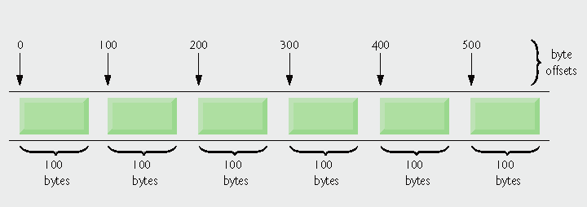
Fig. 17.9 | C++ view of a random-access file.

Slide 19
Random Access Files
Concept: Random Access means non sequential accessing of information in a file
All of the programs we created so far have performed sequential file access
  When the file was opened the position where reading and writing occurred was at the file's beginning (unless ios::app was used which caused data to be written to the end of the file thus far)
  If the file was opened for output, bytes were written to it one after the other
  If the file was opened for input, data was read beginning at the first byte
  As the reading or writing of the file continued, the file stream object's read/write position, advanced sequentially through the file's contents
The problem with sequential file access is that in order to read a specific byte from the file, all the bytes that precede it must be read first
  So if we needed information from the 100th byte in the file, all the bytes that precede it have to be read first (99 bytes)
  Like a tape cassette player
Sequential access can slow a program down tremendously
  If a file is very large information stored deep inside it can take a long time to read

Slide 20
Random Access Files
C++ allows a program to provide random file access
  In random file access, a program may immediately jump to any byte in the file without first reading the preceding bytes
The difference between random access and sequential access is like the difference between a cassette tape and a compact disk
  When listening to a CD. there is no need to listen to or fast forward over unwanted songs, you instead jump to the track that you want to listen to

Slide 21
Random Access File – seekp and seekg
File stream objects have two member functions that are used to move the read/write position to any byte in a file:
  seekp and seekg
The seekp function is used with files opened for output and seekg is used for files opened for input
  Just think that p stands for put and g stands for get
Here's an example of seekp:
  file.seekp(20L, ios::beg);
  The first argument is a long integer representing an offset to a file (the L forces the compiler to treat the number as a long integer)
  This statement moves the files write position to byte number 20
    Remember numbering starts at zero so byte 20 is actually the 21st byte
  The second argument is the mode, which designates where to calculate the offset from
    ios:: beg means the offset is calculated from the beginning of the file

Slide 22
Random Access File – seekp and seekg
The file offset can be calculated from the end of the file for from the current position in the file as well
File positioning Flags:
  ios:: beg – Offset calculated from the beginning of the file
  ios::end – Offset calculated from the end of the file
  ios::cur – Offset calculated from the current position in the file
Some file seek operations
  file.seekp(32L, ios::beg); - sets the write position to the 33rd byte from the beginning of the file
  file.seekp(-10L, ios::end); - sets the write position to the 10 bytes from the end
  file.seekg(40L, ios::cur); - sets the read position 40 bytes from the current position in the file
  file.seekg(0L, ios::end); - sets the read position to the end of the file
Negative offsets can be used, these result in the read or write position being moved backward in the file where a positive position results in a forward movement
Example 4
  Uses a file letters.txt with the following data: abcdefghijklmnopqrstuvwxyz

Slide 23
Random Access File – seekp and seekg
Example 5
  Uses the records we previously created (in file “people.txt”) and displays the second record first followed by the first record
  The program has two important functions other than main
    The first, byteNum, takes a record number as its argument and returns that record's starting byte
      It calculates the record's starting byte by multiplying the record number by the size of the Info structure
        this returns the offset of the record from the beginning of the file
        So we are using a record key here
    The second function, showRec, accepts an Info structure as an argument and displays its contents on the screen

Slide 24
Records and Random Access
Important Note: You can also use classes to create your records instead of structs, you still want to use C-Strings for two reasons
  To avoid pointer problems with write since you must use binary files for this since all the data is not the same type
  To make sure the fields/records are a fixed length
Example 5a
  I did it slightly different from the book, let's look at the program
    The book's version of just the read is in the next few slides

Slide 25
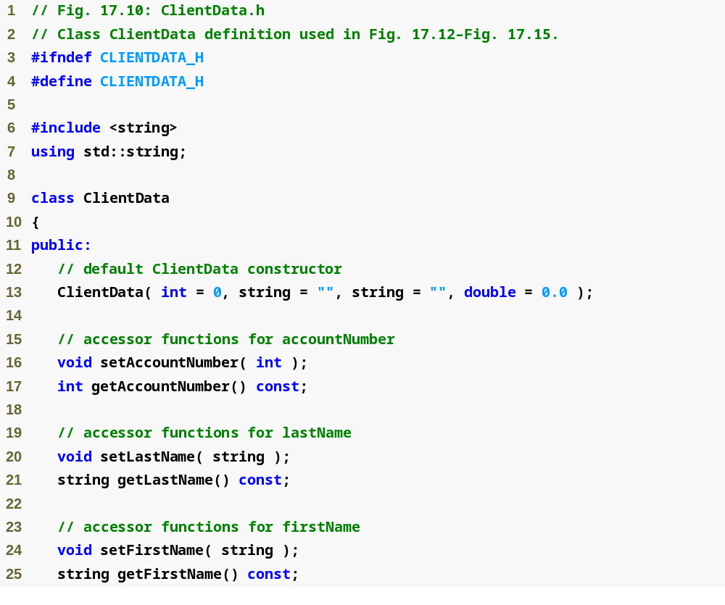
Outline
ClientData.h
(1 of 2)

Slide 26
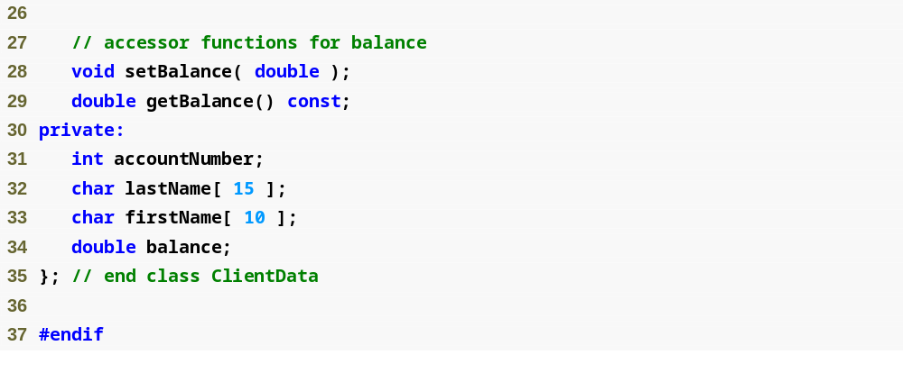
Outline
ClientData.h
(2 of 2)
Store the first and last name in fixed-length char arrays – we cannot use strings because they do not have uniform length

Slide 27
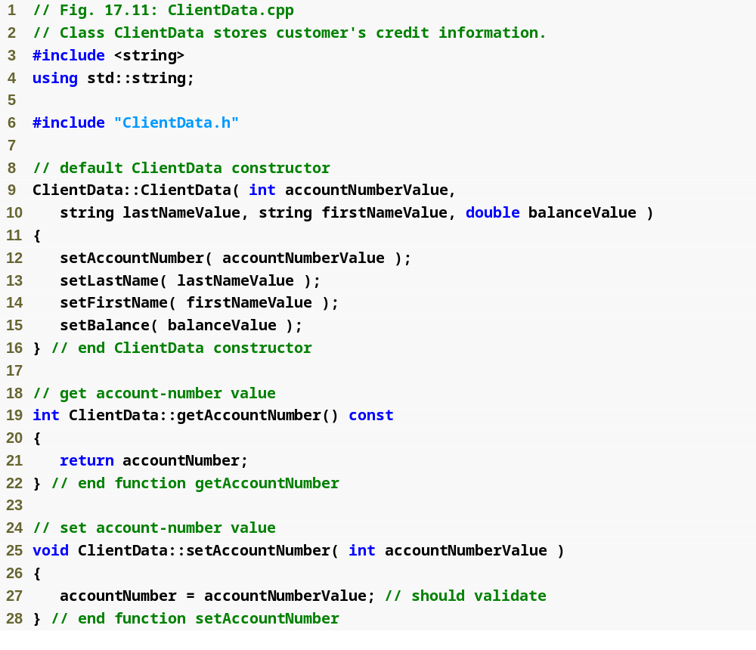
Outline
ClientData.cpp
(1 of 3)

Slide 28
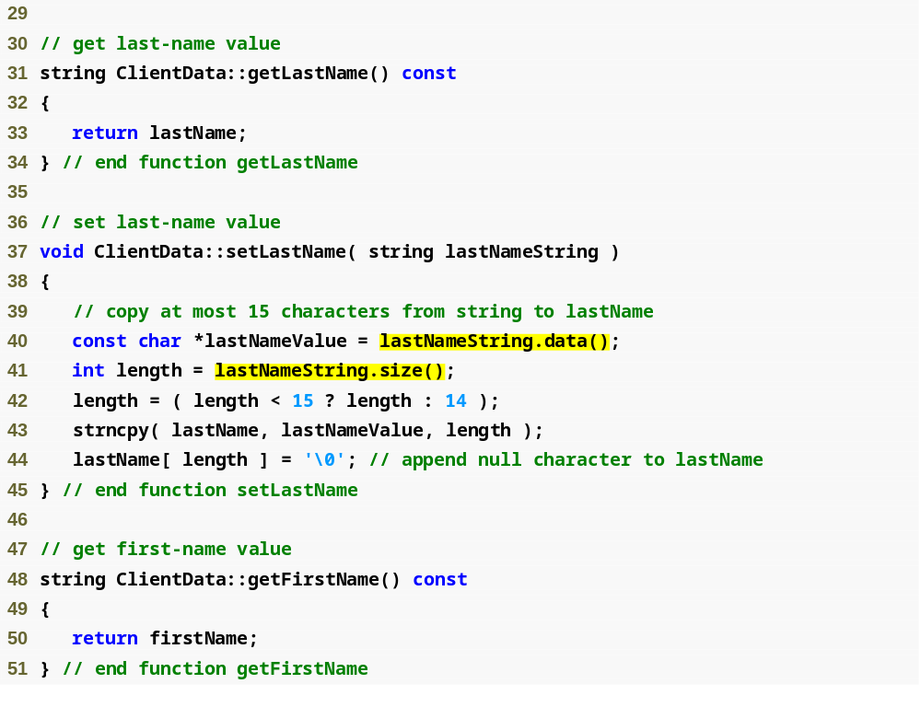
Outline
ClientData.cpp
(2 of 3)
string member function data returns an array containing the characters of the string (not guaranteed to be null terminated)
string member function size returns the length of lastNameString

Slide 29
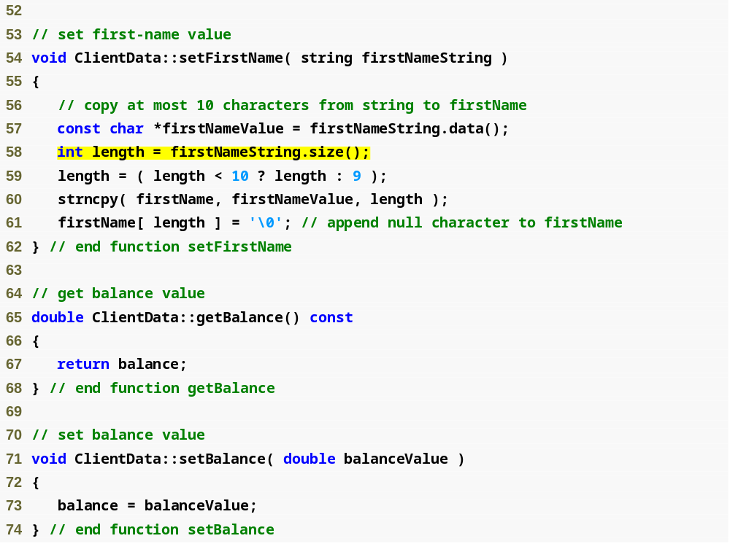
Outline
ClientData.cpp
(3 of 3)

Slide 30
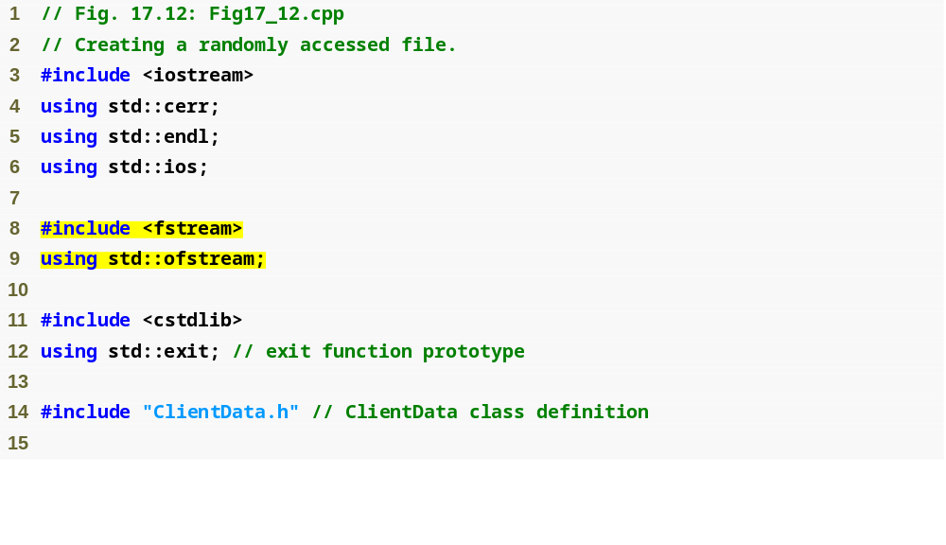
Outline
Fig17_12.cpp
(1 of 2)

Slide 31
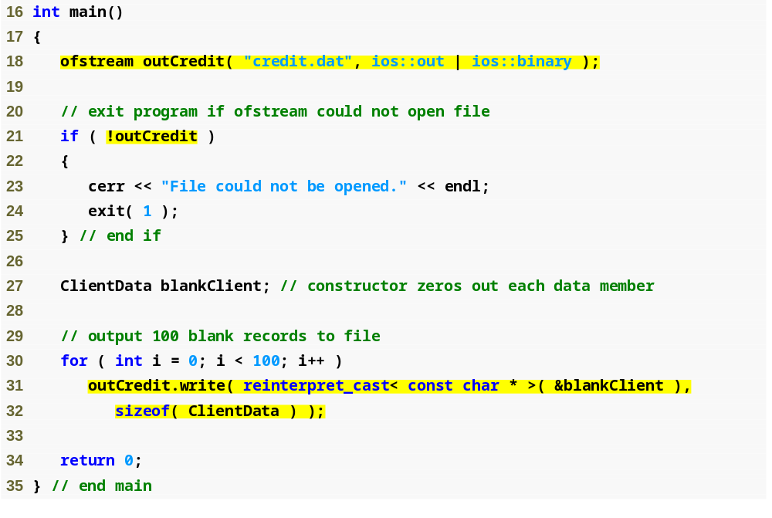
Outline
Open credit.dat in binary mode, which is required to write fixed-length records
Fig17_12.cpp
(2 of 2)
Write the data in blankClient to credit.dat as bytes

Slide 32
Random Access File – tellp and tellg
File stream objects have two more member functions that may be used for random file access:
  tellp and tellg
  The purpose of these member functions is to return, as a long integer, the current byte number of a file's read/write position
  tellp is used to return the write position and tellg is used to return the read position
Assuming pos is a long it, here is an example of the functions' usage
  pos = outFile.tellp();
  pos = inFile.tellg();
Example 6
  Works again with letters.txt

Slide 33
Opening a File for Both Input & Output
Concept: You may perform input and output on an fstream file without closing it and reopening it
Consider a program that allows you to search for a record in a file and then make changes to it
  A read operation is necessary to copy the information from the file to memory
  After the desired changes have been made to the information in memory a write operation is needed to replace the old data in the file with the changed data from memory
To do this just join the ios::in and ios::out file access flags with the | operator like shown in one of the following ways:
  fstream file("data.txt", ios::in | ios::out);
  file.open("data.txt", ios::in | ios::out);
  file.open("data.txt",. ios::in | ios::out | ios::binary);
When a fstream file is opened with both ios::in and ios::out flags, the files current contents are preserved and the read/write position is initially placed at the beginning of the file, if the files does not exist, it is created
Example 7

Slide 34
Object Serialization
When object data members are output to a file the types of the members are lost
  Only the values of the object's data members are stored not their data types
  This is not a problem if the program that reads the data knows the object type to which the data belongs and all the objects being read are the same type
An issue occurs if there are objects of several different types being stored in the same file
  There is no way to distinguish the objects without type information (which we just said is not stored)
The solution is serialization
  A serialized object is an object represented as a sequence of bytes that includes the object's data, information about the object's type, and information about the types of data stored in the object
    After a serialized object is written to a file it can be read from the file and deserialized
      Deserialized just means the information (data and type information) can be used to recreate the object in memory
C++ does not provide a built in serialization mechanism
  However open source libraries and third party libraries are out there that support C++ serialization
  C++ Boost libraries
    provide support for serializing objects in text, binary and XML formats
    www.boost.org/libs/serialization/doc/index.html

